Slide 1
System Programming Getting Started Introduction to System Programming Dr. Muhammad Bilal Qureshi m.qureshi@centralasian.uz
Central Asian University, Tashkent, UZ

Slide 2
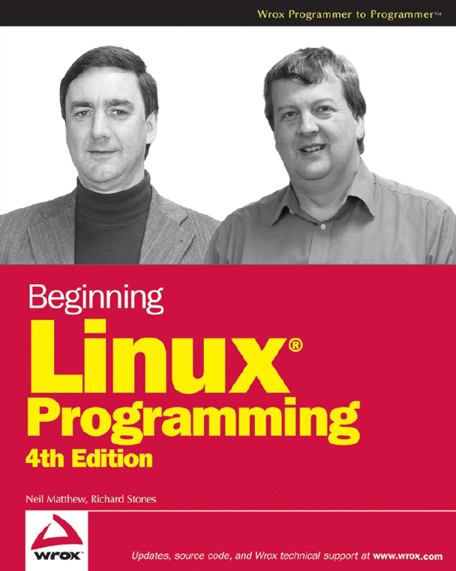
Textbook Reference Book

Slide 3
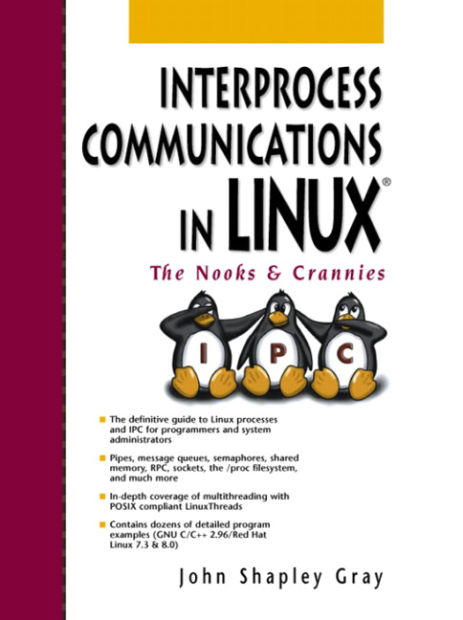
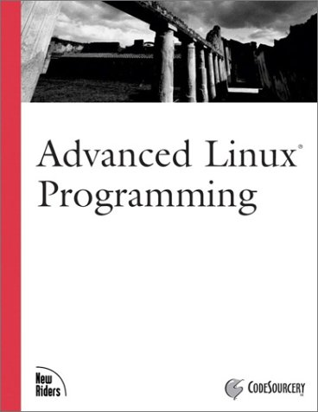
Recommended Reference Books

Slide 4
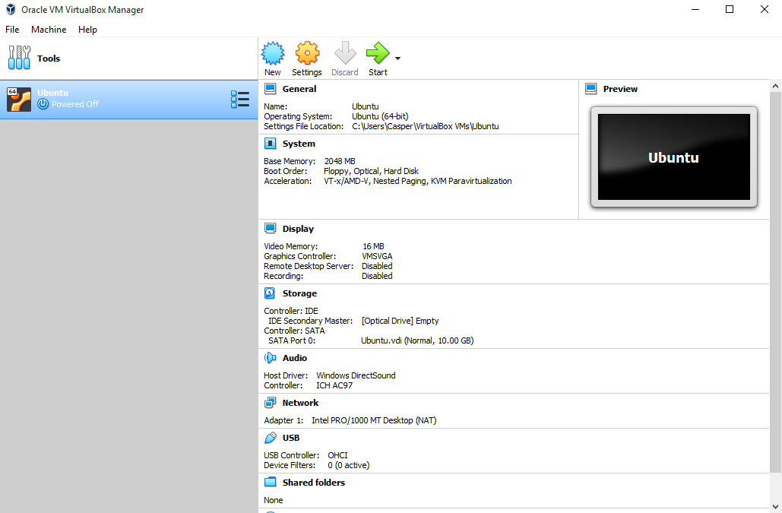
Recommended Software
Oracle VM Virtual Box

Slide 5
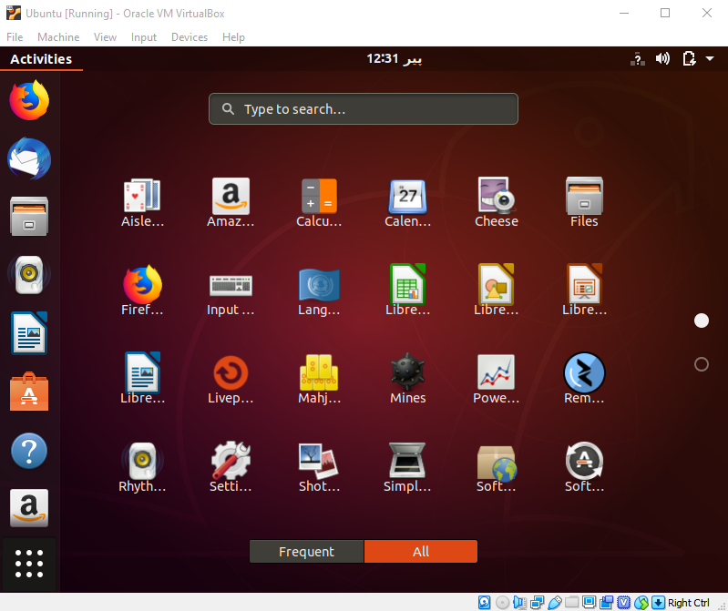
Recommended Software
Ubuntu-18.04.3-desktop-amd64 or onward

Slide 6
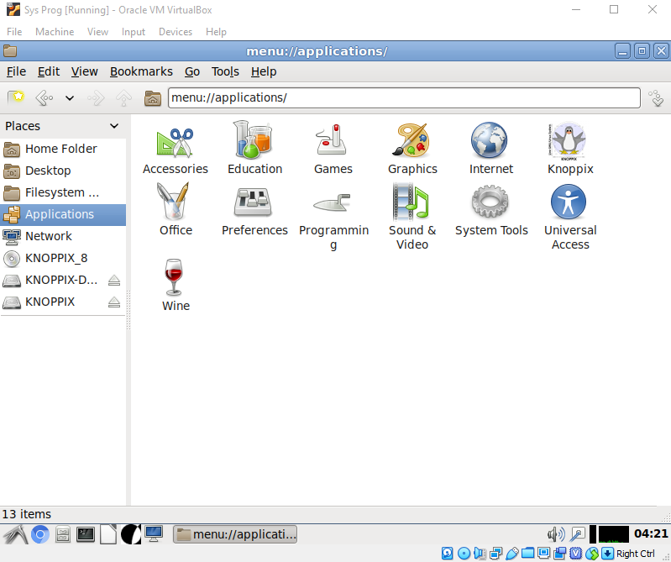
Recommended Software
KNOPPIX_V8.2

Slide 7
Course Outline Overview
Getting Started
An Introduction to UNIX, LINUX and GNU
Programming LINUX
Shell Programming
Why Program with Shell?
Pipes and Redirections
The Shell as Programming Language, Shell Syntax
Working with Files
LINUX File Structure
System Calls and Device Drivers
Library Functions
Low-Level File Access
The Standard I/O Library
File and Directory Maintenance

Slide 8
Course Outline Overview (Cont..)
The LINUX Environment
Program Arguments
Environment Variables
Time and Date
Temporary Files
User Information, Host Information, Logging, Resources & Limits
Processes and Signals
Process Structure
Starting New Processes
Signals
POSIX Threads
Advantages and Drawbacks of Threads
Simultaneous Execution
Synchronization

Slide 9
Course Outline Overview (Cont..)
Inter-Process Communication: Pipes
Process Pipes
Parent and Child Processes
Named Pipes :FIFOs
Sockets
Socket Connections
Network Information
Multiple Clients
Self study Tasks
Programming GNOME Using GTK+
Programming KDE Using Qt
Notes:
GNU Network Object Model Environment.
K Development Environment
GTK (GIMP Toolkit) and Qt are two popular open-source frameworks used for creating graphical user interfaces (GUIs). Both are widely used but differ in design philosophy, features, and target use cases. Here’s a detailed comparison:
GTK:
Excellent support for Linux-based systems (used by GNOME desktop).
Support for Windows and macOS is available but less mature compared to Linux.
Qt:
Strong cross-platform support for Linux, Windows, macOS, iOS, and Android.
Ensures consistent appearance and functionality across platforms.

Slide 10
Marking and Attendance Guidelines
20 % continuous Assessments
2 take home assignments, 2 in classes quizzes (dates will be announced a week before the quiz) – following deadline for assignment is necessary no late assignments will be accepted at all.
30 % midterm
50 % final (30% written exam, 10% a mini project, and 10% lab reports)
No retake allowed, if attendance is less than 50%.
Attendance will usually be taken in first 5-10 minutes, leaving the class will be considered as absent.

Slide 11
Lab / Project Guidelines
A proper formatted pdf must need to be shown from 3rd week till13th week, it will be in group of 3 students.
In the end 1 properly formatted complete pdf required to be uploaded on Eduplus, containing 11 labs.
In the 10th teaching week students will submit proposal for project in groups.
Progress will be evaluated during the lab week 14 and 15, Presentations will be taken place in teaching week 14 or 15.

Slide 12
Recommendations
Prerequisites
Data Structure & Algorithms
Operating Systems
Linux Basics
Why should You study this course?
To become a better C Programmer
To become a Linux Developer
To become a System Level Programmer

Slide 13
What are system programs? Basic def !
System software program work on its own while application software is dependent on it.
System programs are used to program the operating system.
System program are used for operating computer hardware while application software is used according to user application.

Slide 14
Briefly what’s system programming
You write a program in C++ or any other programming language.
What’s the reason to write a program ?
To execute it on a computer and see its output, keeping in mind basic idea is to solve a problem or to automate a task.
Translator
Object code
Executable file
Loader
Output on screen
So, at each stage there is a system program that help execute your source code and show output on the screen.
Notes:
A translator is a program that converts source code written in a high-level programming language or assembly language into machine code (binary code) that a computer can understand and execute. There are three main types of translators:
Compiler: Converts the entire source code into machine code at once (e.g., C compiler).
Interpreter: Converts and executes code line by line (e.g., Python interpreter).
Assembler: Converts assembly language code into machine code.
2. Object Code
Object code is the intermediate, low-level code generated by a compiler or assembler.
It is not yet executable and may require further processing.
It typically contains machine instructions along with references to external functions or libraries.
The file generated is often called an object file and usually has extensions like .obj or .o.
3. Executable File
An executable file is the final output of the compilation and linking process.
It contains machine code that the computer can execute directly.
Linking combines the object code and any required libraries or dependencies to produce the executable.
Executable files often have extensions like .exe (Windows) or no extension (Linux).
4. Loader
A loader is a system software component that loads the executable file into memory for execution.
It allocates memory, resolves symbolic references (like dynamic libraries), and prepares the program for execution by the CPU.
The loader ensures the program has all the resources it needs, such as memory addresses and linked library functions.

Slide 15
System Programming Detailed Explanation
System programming can be defined as the act of building system software using system programming languages.
According to computer hierarchy one which comes at the last is hardware. Then its operating system, system programs and finally application programs.
Program development and execution can be conveniently performed using system programs. Some system programs serve simply as user interfaces to system calls, while others are more complex. These programs traditionally lie between the user interface and system calls.
In context of operating system program are nothing but a special software which give us facility to control computer hardware and resources.

Slide 16
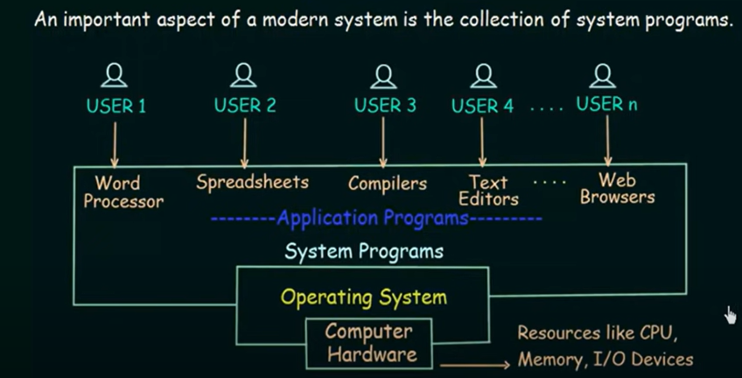
System Programming Detailed Explanation (Cont..)
These programs are closer with operating system so it executes the operation faster and helpful in programming essential operations which can’t be handle by application software.

Slide 17
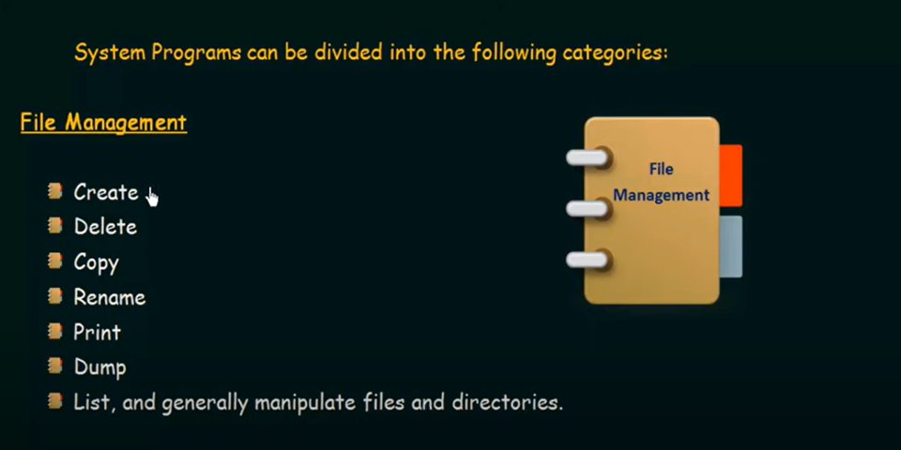
Categories of System Programs

Slide 18
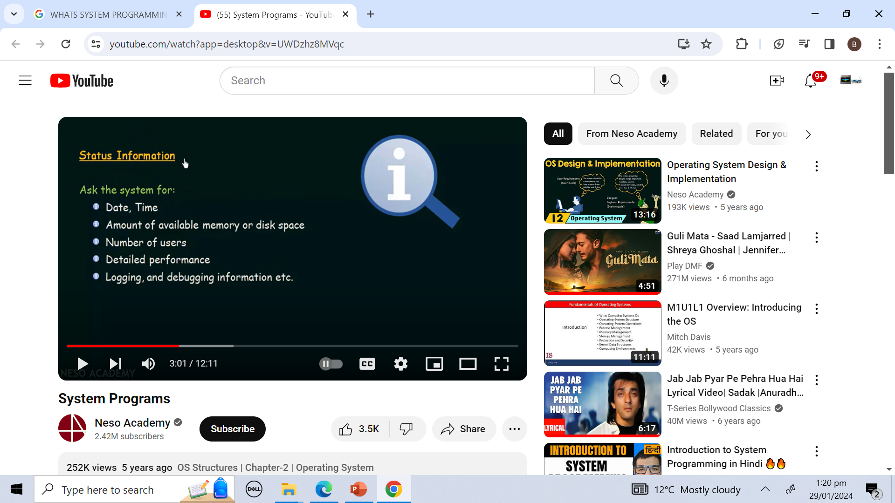
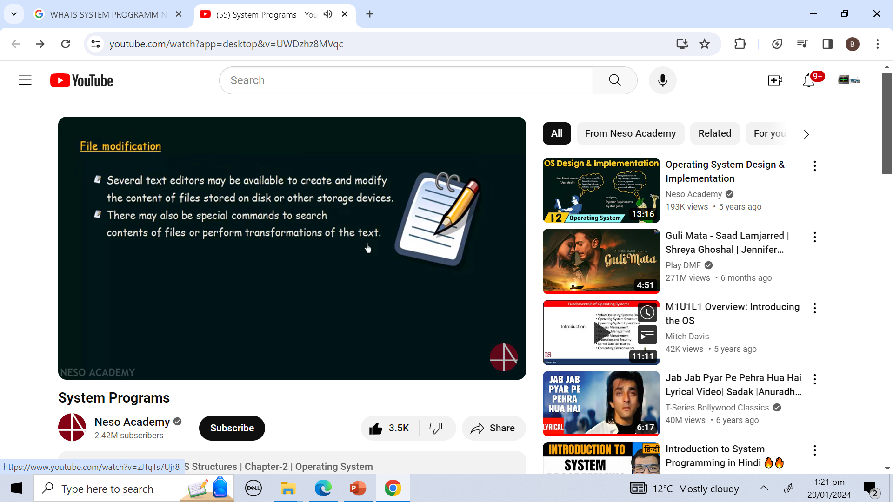
Categories of System Programs

Slide 19
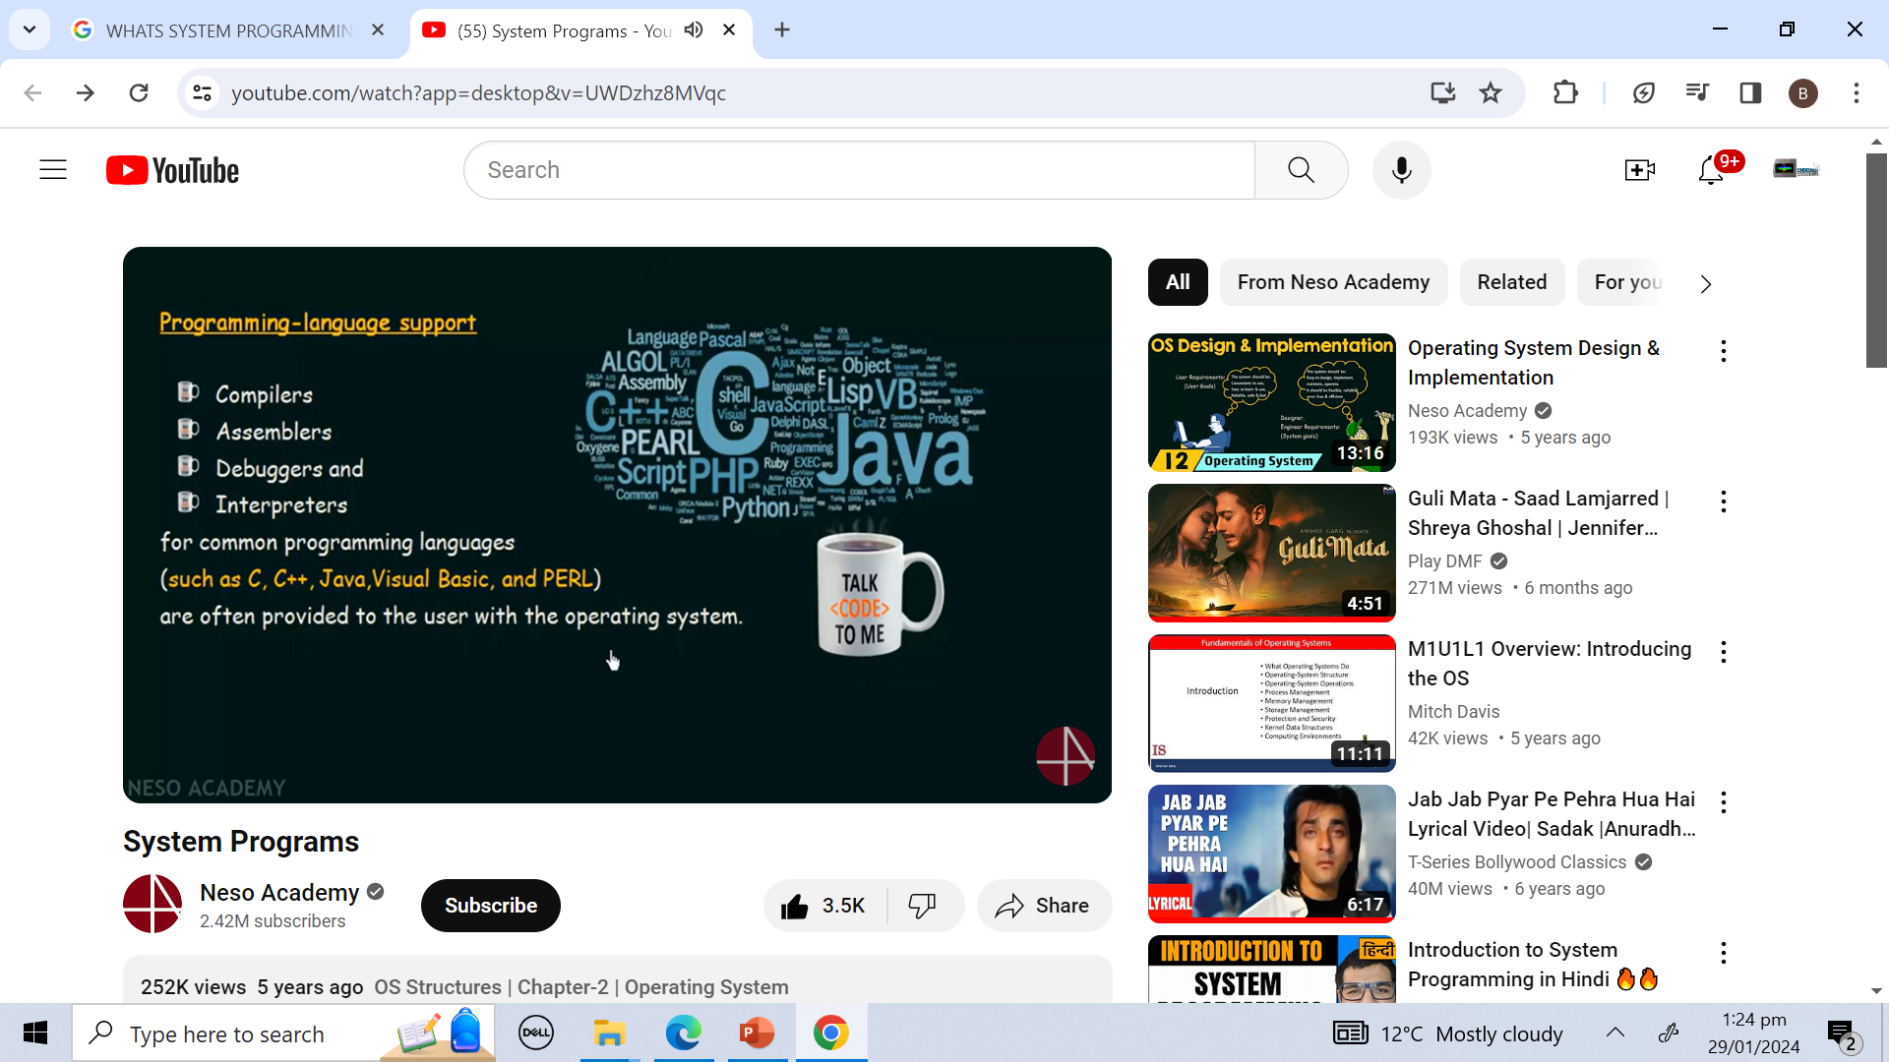
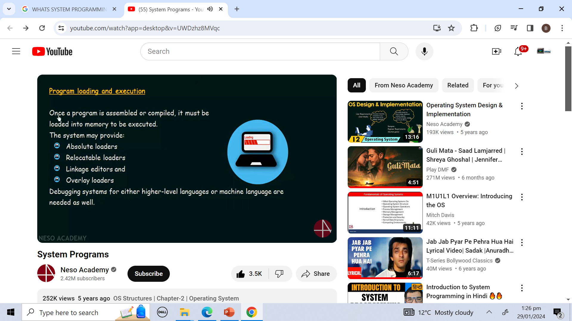
Categories of System Programs

Slide 20
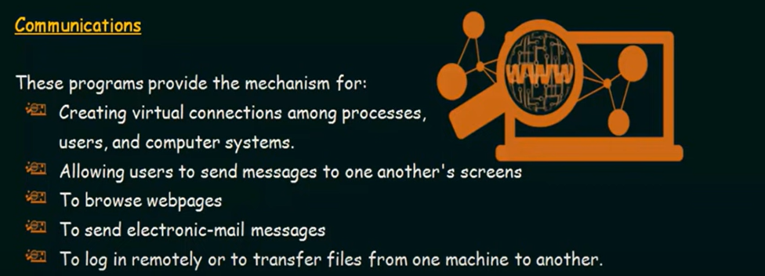
Categories of System Programs

Slide 21
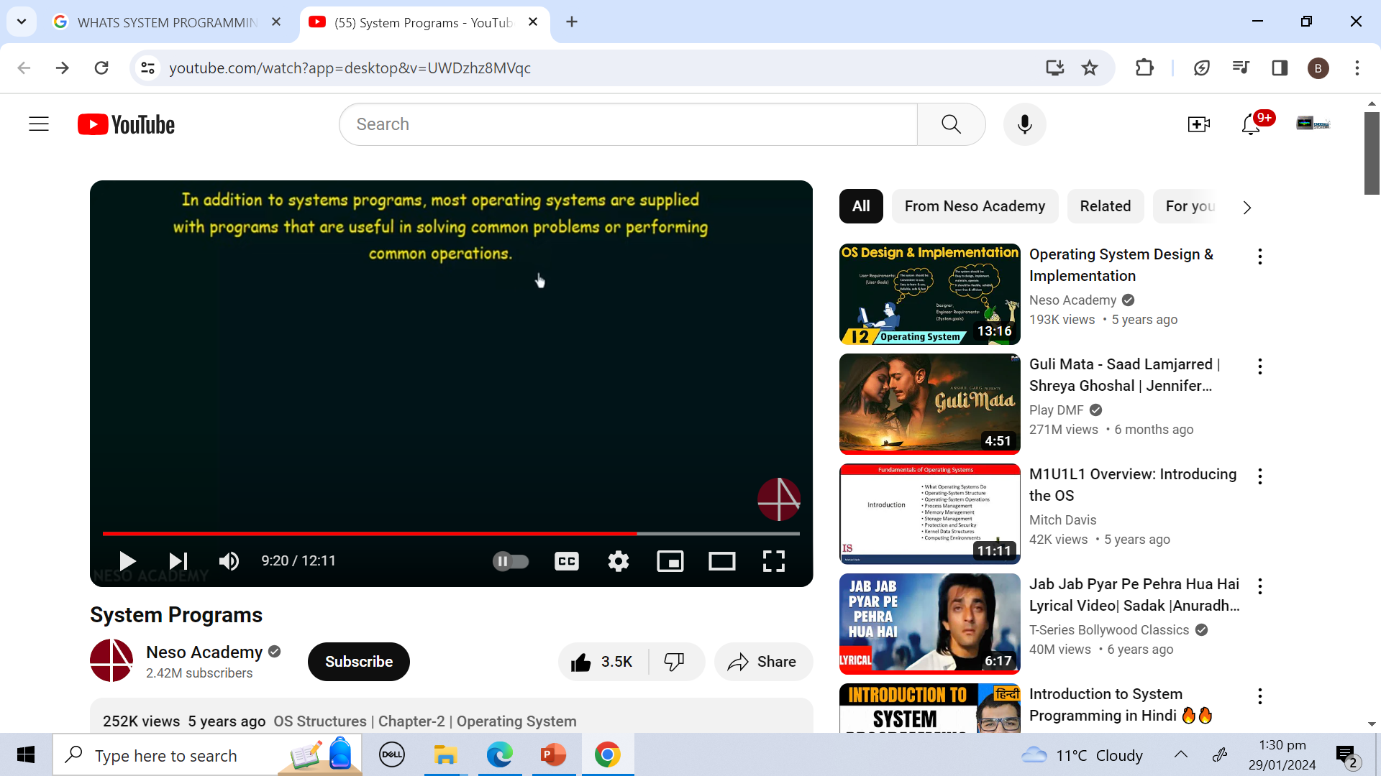
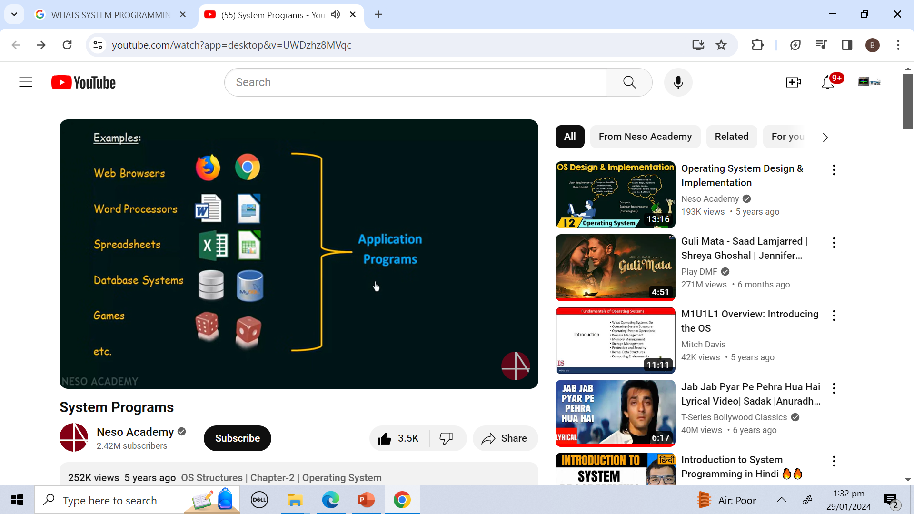
Other programs that comes with OS

Slide 22
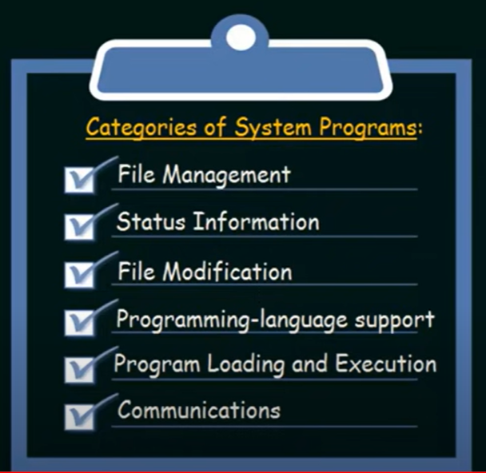
Recap of System Programs categories
Important one : Device Driver (Read out)

Slide 23
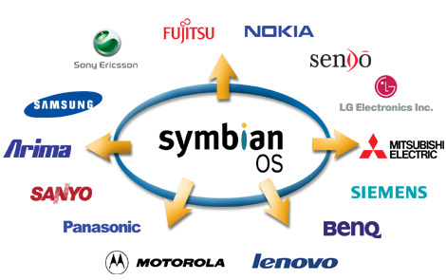





Operating Systems
Operating Systems we know
DOS
Microsoft Windows,
Linux,
Solaris,
Mac OS x
Symbian OS
Android

Slide 24
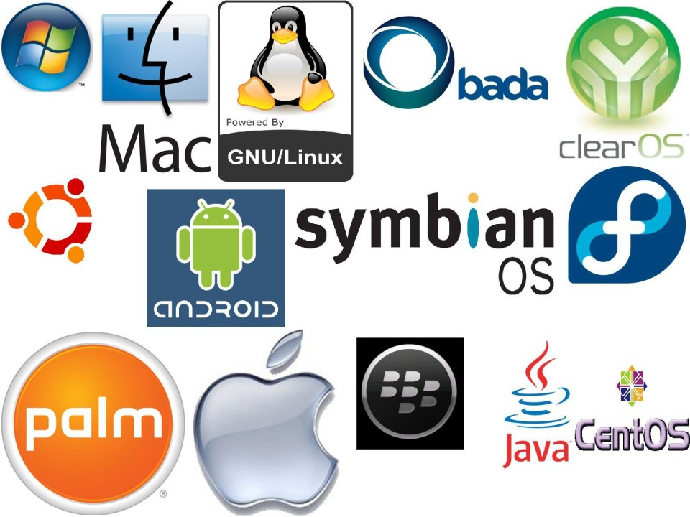
Categorization of Operating Systems
Desktop and Laptop Operating Systems
Microsoft Windows (Windows 10, Windows 11)
macOS (macOS Ventura, macOS Monterey)
Linux (Ubuntu, Fedora, Debian, Mint, Arch Linux)
Chrome OS
Embedded and IoT Operating Systems
FreeRTOS
Embedded Linux (Yocto, Buildroot)
VxWorks
RTEMS
TinyOS
Mobile Operating Systems
Android
iOS
HarmonyOS (by Huawei)
Mainframe Operating Systems
IBM z/OS
Linux on IBM Z
Unisys OS 2200
Specialized Operating Systems
QNX (for automotive and embedded systems)
Raspberry Pi OS (formerly Raspbian)
Tizen (used in Samsung devices)

Slide 25

UNIX
The UNIX operating system originated at Bell Laboratories from AT&T (now USL) in the early 1970's.
It was a very popular multi-user (many users can simultaneously use a single machine), multi-tasking (it can run multiple programs simultaneously) operating system for different platforms, from PC workstations to multiprocessor servers and supercomputers.
Many UNIX-like systems (frequently called flavors) are available commercially such as SCO’s Unixware, IBM’s AIX, HP’s HP-UX, and Sun’s Solaris.
Some have been made available for free, such as FreeBSD and Linux.
Notes:
BSD: Barkely software distribution
USL: Unix shared laboratories
SCO : Santa Cruiz Operation

Slide 26
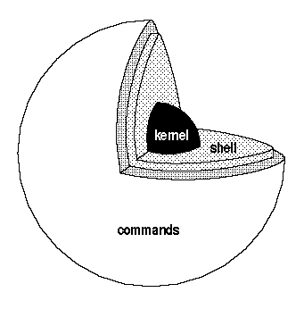
LINUX
Linux (basically the kernel) was developed by
Linus Torvalds at the University of Helsinki,
with the help of UNIX programmers.
The kernel is the program that performs the most
basic functions of an operating system:
It controls and interfaces with the computer’s hardware.
handles allocation of memory and other resources.
allows multiple programs to run at the same time.
manages the file system, and so on.
A user uses shell or GUI Window to interact with the Kernel
Now Linux is used in many different types of CPUs, including 32-bit and 64-bit Intel x86 and compatible processors; workstations and servers using Sun SPARC, IBM PowerPC, AMD Opteron, and Intel Itanium, AMD's x86-64 (AMD64), Smart Phones and Sony’s Playstations 2 and 3.
The name LINUX stands for the recursive LINUX Is Not Unix.

Slide 27
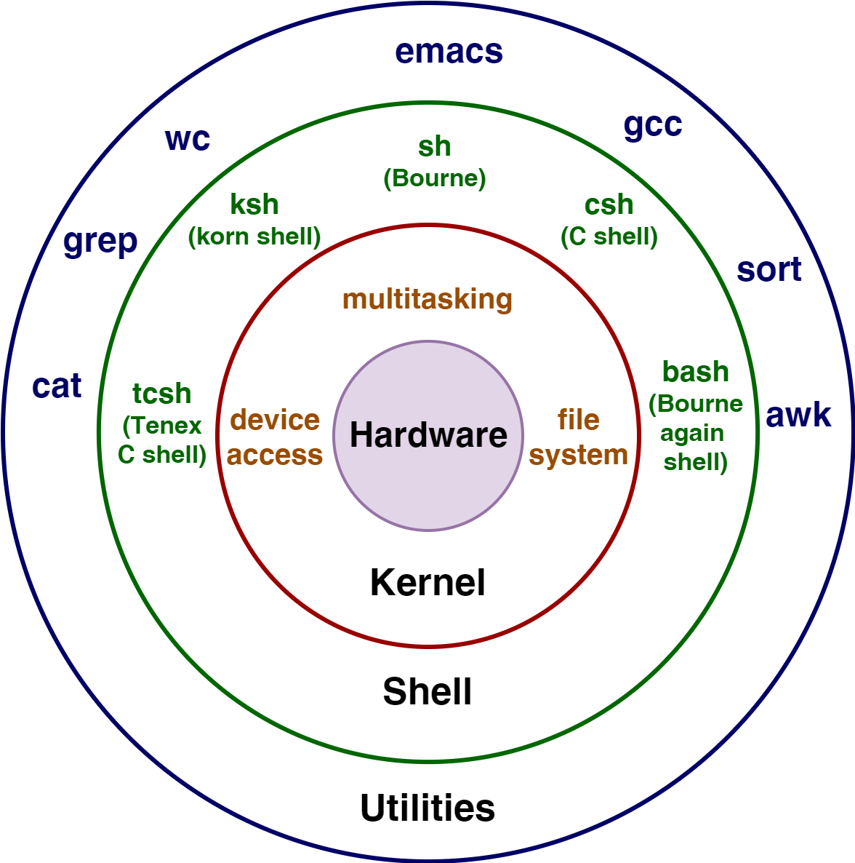

Slide 28

GNU
The name GNU stands for the recursive GNU’s Not Unix.
The Free Software Foundation GNU was set up by Richard Stallman.
Free Software means “there may be a cost involved in obtaining the software, it can thereafter be used in any way desired and is usually distributed in source form”
Some of the free software from the GNU Project:
LINUX: a free UNIX-like system. (KDE, GNOME Desktop)
GCC: The GNU Compiler Collection, containing the GNU C compiler
G++: A C++ compiler, included as part of GCC
GDB: A source code–level debugger
GNU make: A version of UNIX make
Gimp: A graphical image manipulation tool
bash: A command shell
GNU Emacs: A text editor and environment
Notes:
Gnu network object model environment

Slide 29

Linux Programs
Two special types of files: executables and scripts
Executable files are programs that can be run directly
by the computer; they correspond to Windows .exe files.
Scripts are collections of instructions for another program or an interpreter, to follow. These correspond to Windows .bat or .cmd files.
In Linux
Executables or scripts to do not require to have a specific filename or any extension whatsoever.
File system attributes, (discuss later), are used to indicate that a file is a program that may be run.
A shell program (often bash) like command prompt in windows is used to run our programs or commands.
Linux uses Environment Variable, PATH to search command on different paths. e.g. In Linux run this command and see the output
echo $PATH
Notes:
File system attributes : meta data associated with file.
Linux heavily relies on environment variables to configure and control the behavior of the operating system, user environments, and applications. These are key-value pairs stored in memory, accessible to the shell and processes, and are used to define the operating environment.

Slide 30
Linux Programs
The purpose of different paths
/usr/local/bin: programs added by administrators for a specific host computer or local network are found here
/usr/bin: programs supplied by the system for general use
/bin: Binaries, programs used in booting the system
/sbin: for system administrator root
/usr/sbin: for system administrator root
Text Editor
We’ll use Vi text editor for writing C code.

Slide 31
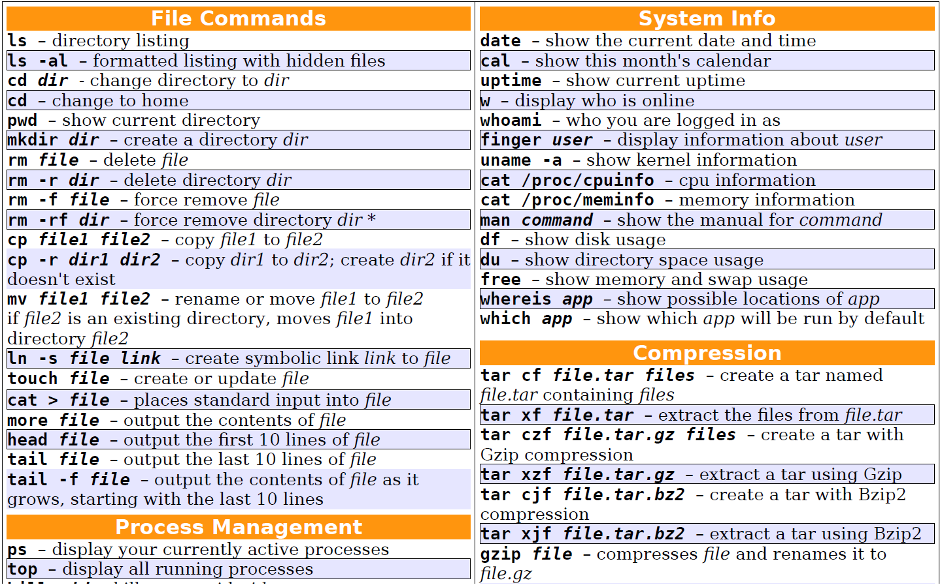
Linux Commands
Notes:
Use online version if any of the command doesn’t work on MAC terminal https://cocalc.com/
Create an account, select visual code, toggle panel (ctrl+j)
Make sure bash is selected.

Slide 32
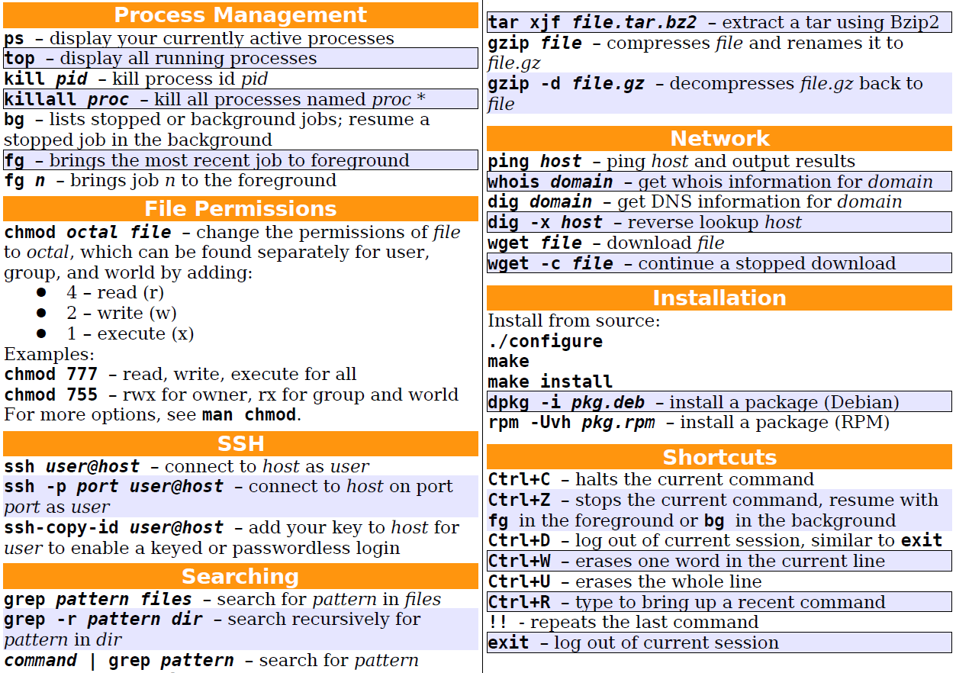
Linux Commands
Notes:
Debian ubuntu
Rpm red hat
Which specific process to which internet or network message is to be forwarded
Ls –l | grep pattern
Upgrade verbose and hash
Whoami --- user name
Ifconfig----

Slide 33

Using Vi Editor 1/6
Assumptions: At the end of commands, if nothing
happens press the ENTER key. Linux is case sensitive
(\a" is not the same as \A").
Entering vi
vimtutor Invokes a tutorial for vi
vi filename Normal way of entering vi
Saving and Exiting
ZZ Quit and Save
:wq Quit and Save
:q! Force quit and ignore changes
:w Save changes and stay in file
:f file Change current filename to file

Slide 34
Using Vi Editor 2/6
Positioning the Cursor
G Go to last line in file
nG Go to line number n
:n Go to line number n
b Back one word
w Start of next word
( Beginning of previous sentence
) Beginning of next sentence
f Beginning of previous paragraph
g Beginning of next paragraph
H Home-top line on screen
L Last line on screen

Slide 35
Using Vi Editor 3/6
Inserting New Text
i Insert before cursor
I Insert at beginning of line
a Insert after line
A Append to end of line
o Insert one line below cursor
O Insert one line above cursor
Esc Terminate insert mode
Searching
/string Search forward for string
?string Search backward for string
:s/old/new/n Search and replace at n occurence
Notes:
:s/foo/bar/2
Only the 2nd foo on the current line is replaced.
:s/foo/bar/g
Adding the g flag makes it global, replacing all occurrences on the line.
:s/old/new
Replace the 1st occurrence of old with new (default behavior):

Slide 36
Using Vi Editor 4/6
Deleting and Copying Text
x Delete character at current cursor position
dd Delete current line
dw Delete a word
ndd Delete n lines
ndw Delete n words
D Delete remainder of line
Y or yy Copy current line to new buffer
p Place buffer contents after cursor or
Place last deleted text after cursor
P Place buffer contents before cursor or
Place last deleted text before cursor

Slide 37
Using Vi Editor 5/6
Changing Text
rx Replace character with x
R Replace beginning at cursor
cw Change word
cc Change line
C Change to end of line
Miscellaneous Commands
:!command Issue LINUX command from within vi
J Join two lines
:r file Append file into vi
Z Redraw the screen (ctrl+l)
. Repeat recently written
u Undo recently written

Slide 38
Using Vi Editor 6/6
Positioning the Cursor
k Move up one line
j Move down one line
l Move right one character
h Move left one character h
(You can use arrow keys for above functions)
^B Scroll back one screen
^F Scroll forward one screen
^U Scroll back half screen
^D Scroll forward half screen
0 Go to first position on current line
$ Go to last position on current line

Slide 39
Your First Linux C Program
Type vi hello.c on shell, press i
Type following code in hello.c file.
Press Esc key
Save and Exit :wq
Now compile the code gcc hello.c
Run the Program ./a.out
hello.c
#include <stdio.h>
#include <stdlib.h>
int main()
{
printf("Hello World\n");
exit(0);
}

Slide 40
Using gcc Compiler
Type this command ls to see list for files
Now compile in this way gcc –o hello hello.c
Run the Program ./hello
Header Files are placed at /usr/include
To see which of the header files contains EXIT_ word type following commands.
cd /usr/include
grep EXIT_ *.h
Library Files are usually placed in /lib and /usr/lib directory
A library filename always starts with lib
Then follows the part indicating what library is this
(like c for the C library, or m for the mathematical library).

Slide 41
Library Files
The last part of the name starts with a dot (.) and specifies the type of the library
.a for static libraries
.so for shared libraries
Examples
/usr/lib/libc.so.6 is a standard C shared library in version 6
/usr/lib/libm.a is a standard C static library for math functions
when a shared library is linked into a program, the final executable does not actually contain the code that is present in the shared library
The executable merely contains a reference to the shared library.
If several programs on the system are linked against the same shared library, they will all reference that library, but none will actually be included. Thus, the library is “shared” among all the programs that link with it. So the size of program is reduced and the space is saved.
Type following command ldd a.out and see the output
Notes:
Shared libraries required by our program
List dynamic dependencies

Slide 42
Library Files
When a code is compiled against a statically linked library, the code for any referenced library routine is included directly in the resulting program binary.
This results in very large application executables because each one contains a duplicate of standard routines.
Analogies between Windows and Linux
Item Linux Windows
object module func.o func.obj
static library lib.a lib.lib
shared library lib.so lib.dll
program program program.exe

Slide 43
Try It Out Static Libraries 1/3
In this example, you create your own small library containing two functions and then use one of them in an example program. The functions are called fred and bill and just print greetings.
First, create separate source files (imaginatively called fred.c and bill.c) for each function.
fred.c
// this is fred.c
#include <stdio.h>
void fred(int arg){
printf("fred: we passed %d\n", arg);
}
bill.c
// this is bill.c
#include <stdio.h>
void bill(char *arg){
printf("Bill: we passed %s\n", arg);
}

Slide 44
Try It Out Static Libraries 2/3
Produce object files of both fred.c and bill.c
gcc –c fred.c bill.c
ls *.o
Create a header file for our library. This will declare the functions fred() and bill() present in our library
Include the library header file in our calling program and calls one of the functions from the library
lib.h
void fred(int arg);
void bill(char *arg);
program.c
// this is program.c
#include <stdlib.h>
#include "lib.h"
int main(){
bill("Hello World");
exit(0);
}
Notes:
sudo apt install gcc -y

Slide 45
Try It Out Static Libraries 3/3
compile our file program.c and link it with the previously compiled object module bill.o
gcc -c program.c
gcc -o program program.o fred.o bill.o
./program
create our own library called libfoo.a
ar crv libfoo.a bill.o fred.o
create a table of contents for the library, make the library ready to use
ranlib libfoo.a
use this library to link to program.o
gcc -o program program.o libfoo.a
./program
OR You can use a shorthand notation
gcc -o program program.o -L. -lfoo
Notes:
6. Ar archieve used to create modify and extract the files from the archieves (create , replace, verbose (detailed output using operation)
6. Creating a static library
7. Ranlib creates index for static library
8. Linking
9. Ldd program1 (list of necessary shared libraries) ldd stands for "list dynamic dependencies". It is a command-line tool in Linux used to display the shared libraries (dynamic dependencies) required by an executable or a shared object file.

Slide 46
man for help
Section contents
1 user commands
2 system calls
3 C library functions
4 devices and network interfaces
5 file formats
6 games and demos
7 environments, tables and macros
8 system maintenance
e.g. man 1 printf
man 3 printf
indent program.c
man indent

Slide 47
Thank You
Questions?

